Slide 1
Senior Projects Final Presentation
Ryan Fleury

Slide 2

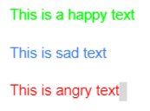
The Application
The purpose of the application was to be able to predict the emotion of any moderate length text document or sample that is inputted into the GUI.
Example: Text: I feel good today Emotion: happy
The Goal for this summer was to try and improve the project past the MVP, which was reached last semester.
Text within file will be highlighted in a different color based on emotion/tone.
Take in a file such as a word document

Slide 3
Functional Requirements
The program must analyze text documents text for emotion.
The program must have a graphical interface that acts as a text editor.
The program must highlight text based on the emotion grade it receives.
The program must have a way to recognize the amount of input text in the program. (Impacts accuracy of prediction lower amount of text present).
The program must pull text from multiple sources to eliminate Bias.
The program must be able to analyze text regardless of the amount of input text.

Slide 4
Non-Functional Requirements
The program GUI shall look much better than previous iterations of the program.
The program shall be able to perform more efficiently with large amounts of input text.
The program shall adapt better to being used on multiple systems.
The program shall have embedded instructions on how to make it function.
The program shall accept multiple types of documents. (Word and .txt)
The program shall have a prediction accuracy higher than 35%.

Slide 5
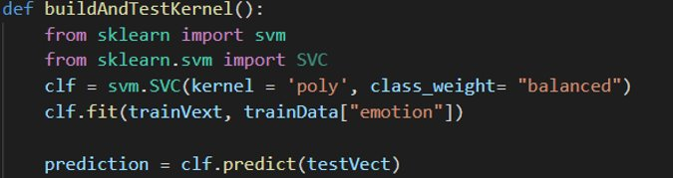
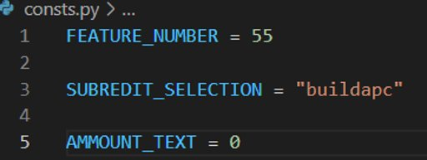
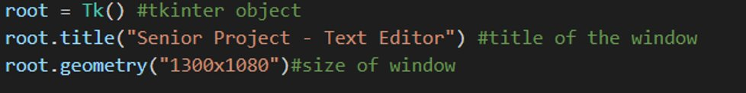
Main Projects Points
Kernel Building
Constant Variables
Text Tagging
Text Box Window

Slide 6
What I wanted to accomplish this summer
Text sampling amount required
GUI design and interface
Types of files that can be used
Instructions for the program to use
Adaptability on multiple systems

Slide 7
What was accomplished overview
Redesign of the GUI interface
Program was made easier to use
Text sampling was addressed but not fixed
Pulls from reddit are now random
Codebase was redesigned and more structured

Slide 8
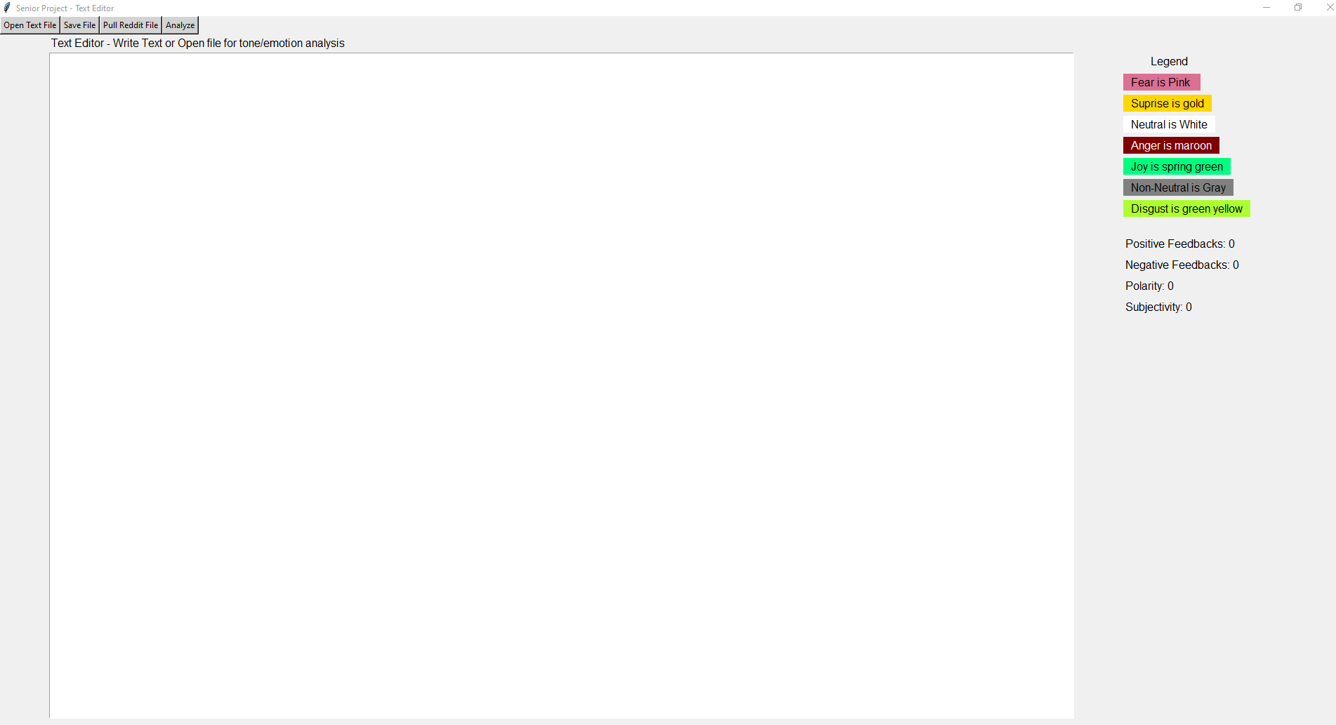
What was accomplished
GUI Redesign

Slide 9

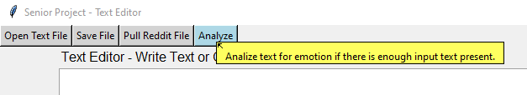
What was accomplished
Program was made easier to use
Program instructions added
Can open Word or Text files

Slide 10
What was accomplished
Program will pull from multiple subreddits at random
More reddit Data is pulled to address input text requirement issues

Slide 11
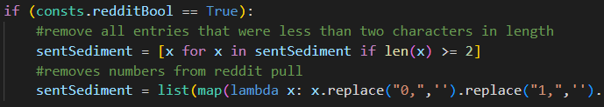

What was accomplished
Data from reddit will be preprocessed.
Program is more stable
Codebase was redesigned

Slide 12
What did not get accomplished
I wanted a new dataset for training to accomplish more accuracy
Program is more efficient than before but not where I want it to be
Imbedded instructions
Large amount of input text is still needed

Slide 13
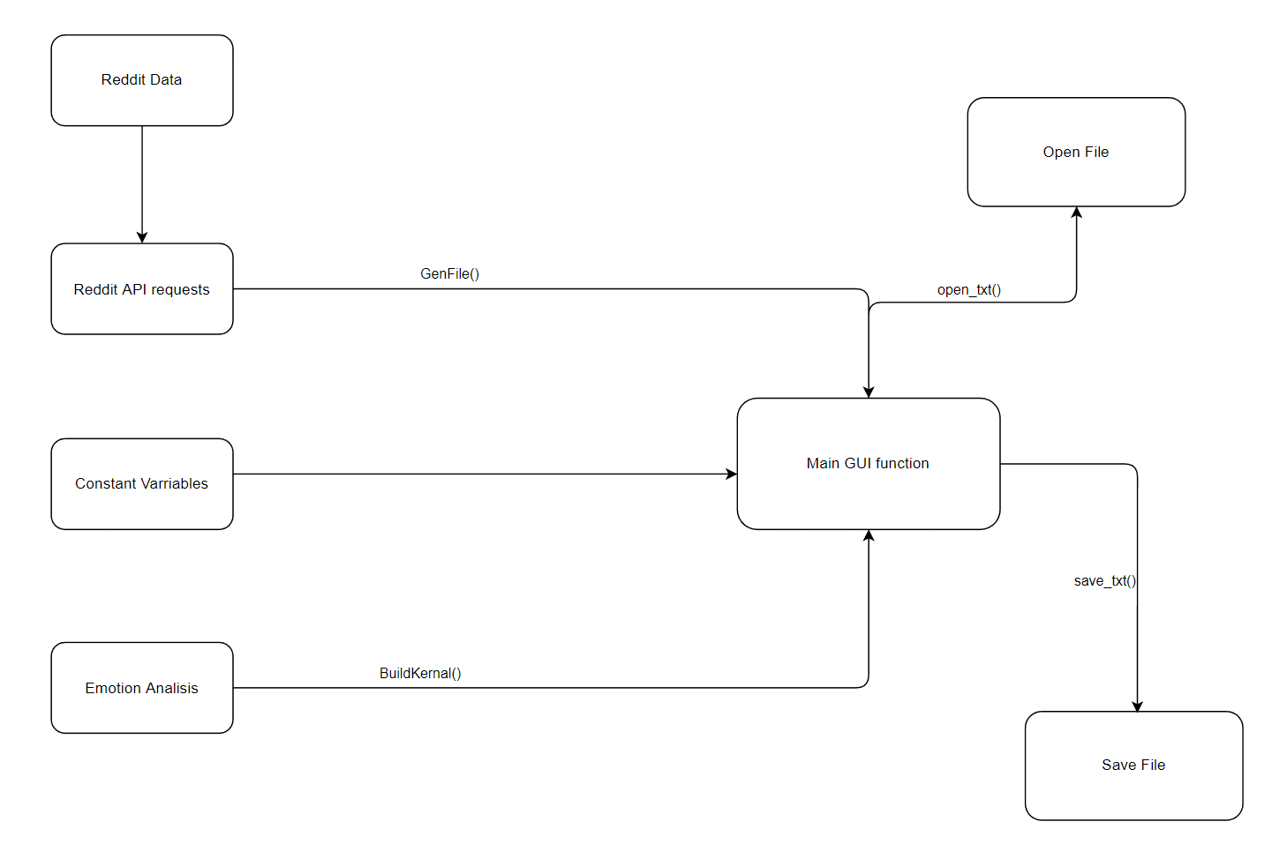
Current High Level Design

Slide 14
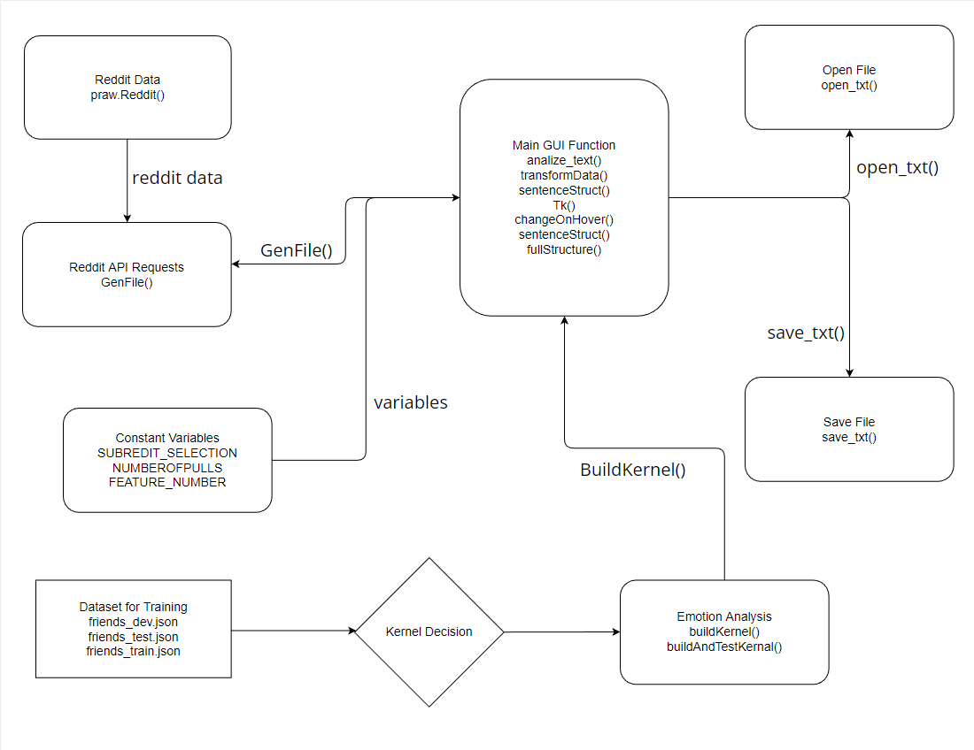
In depth Design

Slide 15
Demo

